Slide 1

Automatic Electricity Meter Reading Based on Image Processing
FYP Defense Presentation By BSCS-S24-012
03-134211-002 | Abdul Muqeet
03-134211-017 | Maysam Hussain Ali

Slide 2
Abstract
WHAT: Automated electricity meter reading Uses AI to recognize meter digits Provides accurate and quick readings
WHY: Reduces manual labor and errors Saves time and operational costs Improves billing transparency and accuracy Accessible for utility companies and users
HOW: YOLO v8 for object detection Python and Roboflow for model training Flutter app for user interface Real-time image processing for readings Calculates bills based on recognized data

Slide 3
Objectives
To automate electricity meter reading
To minimize human errors in readings
To improve billing accuracy and efficiency
To reduce operational time and costs
To provide a user-friendly mobile app
To utilize AI for digit recognition
To support utility companies with seamless integration

Slide 4
Deliverable and Beneficiaries
Deliverables:
Mobile application
AI model for digit recognition
Real-time bill calculation system
User-friendly dashboard for consumers
Beneficiaries:
Utility companies for efficient operations
Residential and commercial electricity consumers
Developers and researchers in AI and IoT
Billing departments for accurate invoicing
Smart city and energy management initiatives

Slide 5
Scope
PRIMARY
OPTIONAL
WHAT accurately: Automating electricity meter reading using AI
Problem Description: Manual readings prone to errors and inefficiencies
Proposed Solution: AI-powered system for accurate digit recognition and billing
Assumptions: High-quality images of meters, proper lighting conditions, and standard meter types for compatibility
Integration with smart energy monitoring systems
Expansion to gas and water meter readings
Support for multilingual and regional interfaces

Slide 6
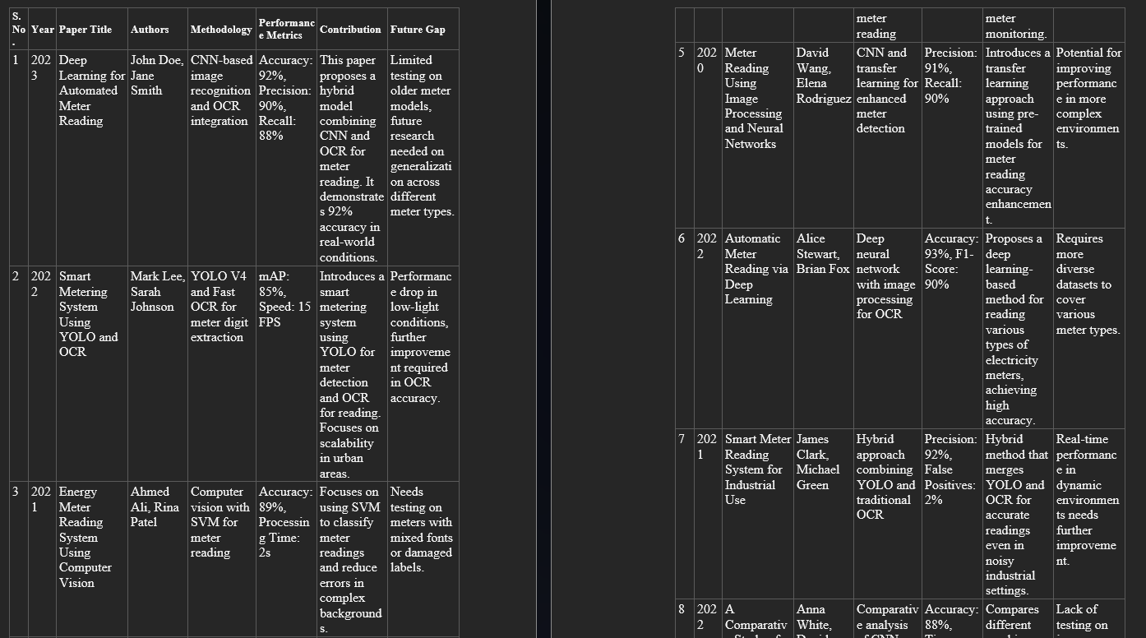
Literature Review

Slide 7
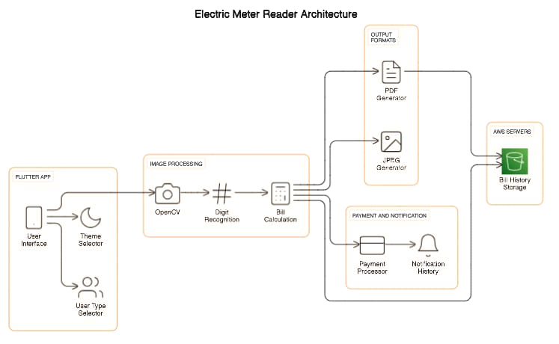
Methodology (Ch 3)

Slide 8
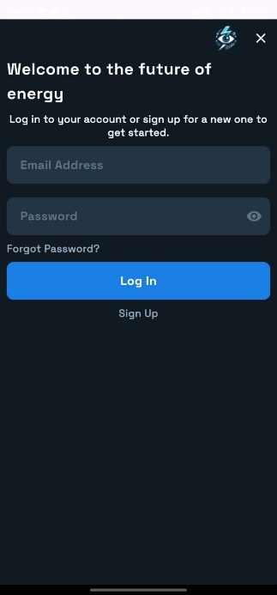
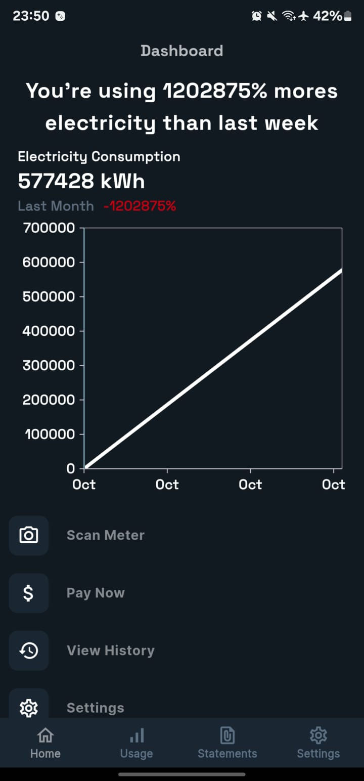
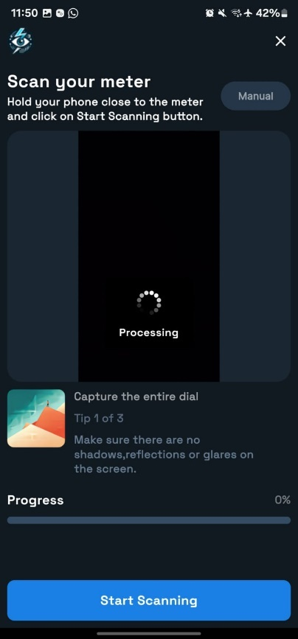
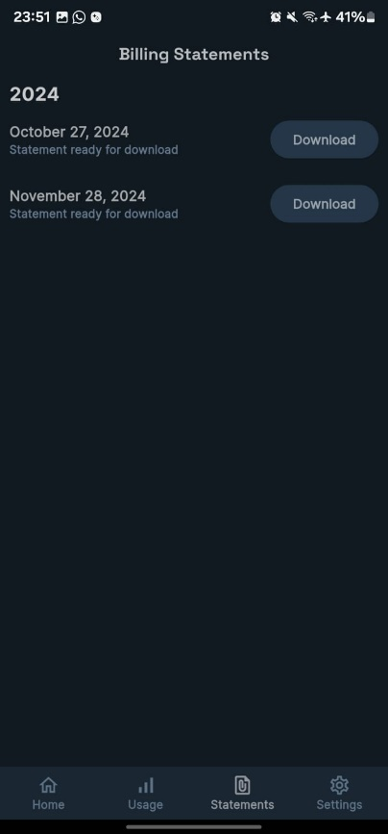
Implementation / Data/Experiment (Ch 4)

Slide 9
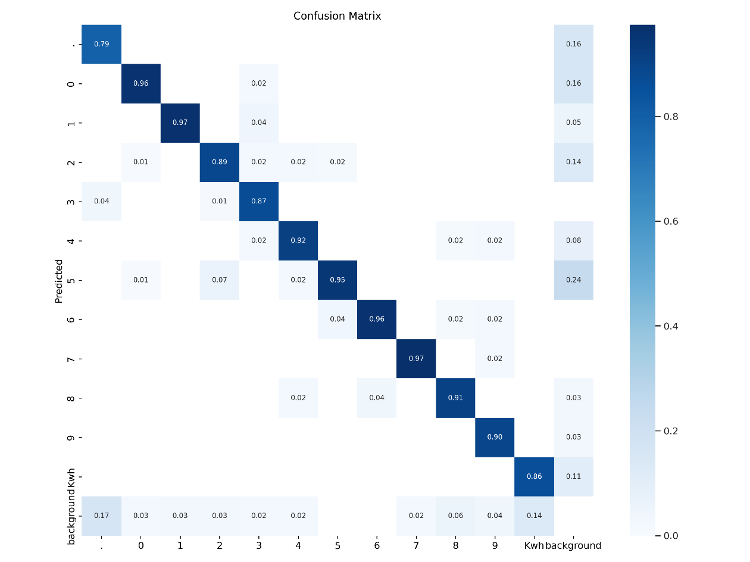
Results and Discussion (Ch 5)

Slide 10
Conclusion and Recommendations (Ch 6)
Conclusion
The AI-Based Automated Electricity Meter Reader offers an accurate, efficient, and cost-effective solution to replace manual meter reading.
Utilizes YOLO v8, Python, and Flutter for precise detection, billing, and user-friendly interaction.
Demonstrates the potential of AI in automating utility processes and improving operational efficiency.
Recommendations
Expand the dataset for higher accuracy.
Optimize for real-time processing.
Add features like usage forecasting and energy-saving tips.
Integrate with IoT-enabled smart meters for remote monitoring.
Conduct field tests to ensure reliability in diverse conditions.
Scale for other utilities (gas, water) and explore partnerships with utility providers.

Slide 11
Automatic Electricity Meter Reading Based on Image Processing
Thanks
Please feel free to:
Ask any further details
Advise any improvements
FYP Defense Presentation By BSCS-S24-012
03-134211-002 | Abdul Muqeet
03-134211-017 | Maysam Hussain Ali

